Slide 1

Q1 –Task1
Business Analyst - Case & Behavioural Interview – Franco Fan
What are the various interactions (for the borrower and for the lender) and key characteristics of the portal that you think will be necessary to facilitate a good experience?
To answer this question, my approach is to:
Ideation
Know the business (market research, competitor analysis)
Gather requirements (solution outline)
Define solution (construct components)
Picture product (product mapping & final touch)

Slide 2
Role in Lending business
Define roles within simplified workflow
Borrower (And potential clients)
Loan Operator
(Case operations includes customer servicing, technical support roles)
Loan Approver
(Evaluating cases, assessing creditworthiness,
analyzing financial documents, loan approval decision maker)
External Service Provider
(External partners for completing the workflow, such as
ID verification solution vendor, Credit Reporting Agencies)

Slide 3
Borrower perspective, portal requirement:
Expectation and rationale: (Assume no priority in orders)
List top 10 wishes and rationale as client
Anytime everywhere - Accessible by their own device and easy to use by everybody
Efficient - Workflow process are efficient, Simple user interface
Predictable - Ability to predict loan schedule, repayment information before application
Secured - Capable in information protection
Accessibility - Round-the-clock accessibility
Informative - Ability to provide detailed loan information and deliver notification
Customized service - Adaptability for customized user experience (e.g. notification channel, payment method)
Progress update - Ability for real-time update
Payment reminder - Reliable in scheduled reminder to avoid penalties
Device friendly - Accessibility for any devices (e.g. Mobile, Windows/ Mac, IPad)

Slide 4
Lender perspective, portal requirement:
Expectation and rationale: (Assume no priority in orders)
List top 10 wishes and rationale as business owner
Compliance - Adaptability for regulatory standards to avoid operational risk (fines, license cancellation)
Standardize - Universal workflow design for diverse products
Business Intelligence - Capability in business analytics (client value, operational KPIs, product trend)
Easy-to-use - Accessible for everybody
Authorization - Ability in setting customized authorization level between users to facilitate business use cases
Automation - Ability in automated risk monitoring, KPIs tracking, notifications
Exceptional handling – Adaptability in manual intervention
Secured - Reliability in information protection
Communication - Ability to facilitate users communication
Editable - Flexibility to facilitate adjustment in product information, client profiles, promotion materials

Slide 5
Q1Task1 Various interactions (for both borrower and lender) and key characteristics of portal to facilitate good experience
Various interactions:
Anytime everywhere
Efficient
Predictable
Secured
High availability
Informative
Customized service
Progress update
Reminder for payment
Device friendly
Key Characteristics:
Reliable, high availability system architecture
User-friendly interface, efficient workflow design
Progress bar to show application status
Secured in information protection
Business analytic service for borrower and lender
Payment reminder
Responsive web application
Adaptability in regulatory adjustment
Universal design to fit 3 types of loan product
Ability for different user authorization level
Process automation for enhanced efficiency
Manual intervention possibility
Chat functions between users
Compliance
Standardize
Business Intelligence
Easy-to-use
Authorization
Automation
Exceptional capability
Secured
Communication
Editable
*Revisit to the list after completion of workflow/ use case diagram to ensure every essential characteristics are captured.
(added after diagram is completed): Database Recovery, Connectivity to external vendor (these are crucial for operation efficiency, should be count into Key Characteristics)

Slide 6
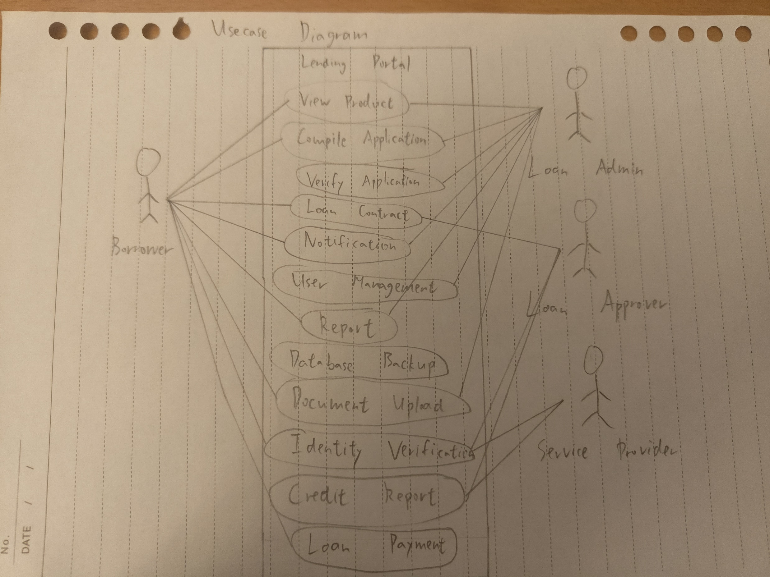
Functional Use Case Diagram
Borrower
view product
compile application
loan contract
loan payment
notification
report
document upload
Loan admin
view product
compile application
verify application
loan payment
notification
report
user management
document upload
Loan approver
loan contract
identity verification
credit report
Service Provider
Identity verification
Credit report
Remarks: 3 main roles in loan processing (simplified)
Loan admin involves in case processing excluding approval.
Loan approver acts as independent risk gatekeeper, focusing on Loan decisioning.
Service Provider (external vendor) facilitating the workflow (Electronic ID verification/ Credit rating service provider)

Slide 7
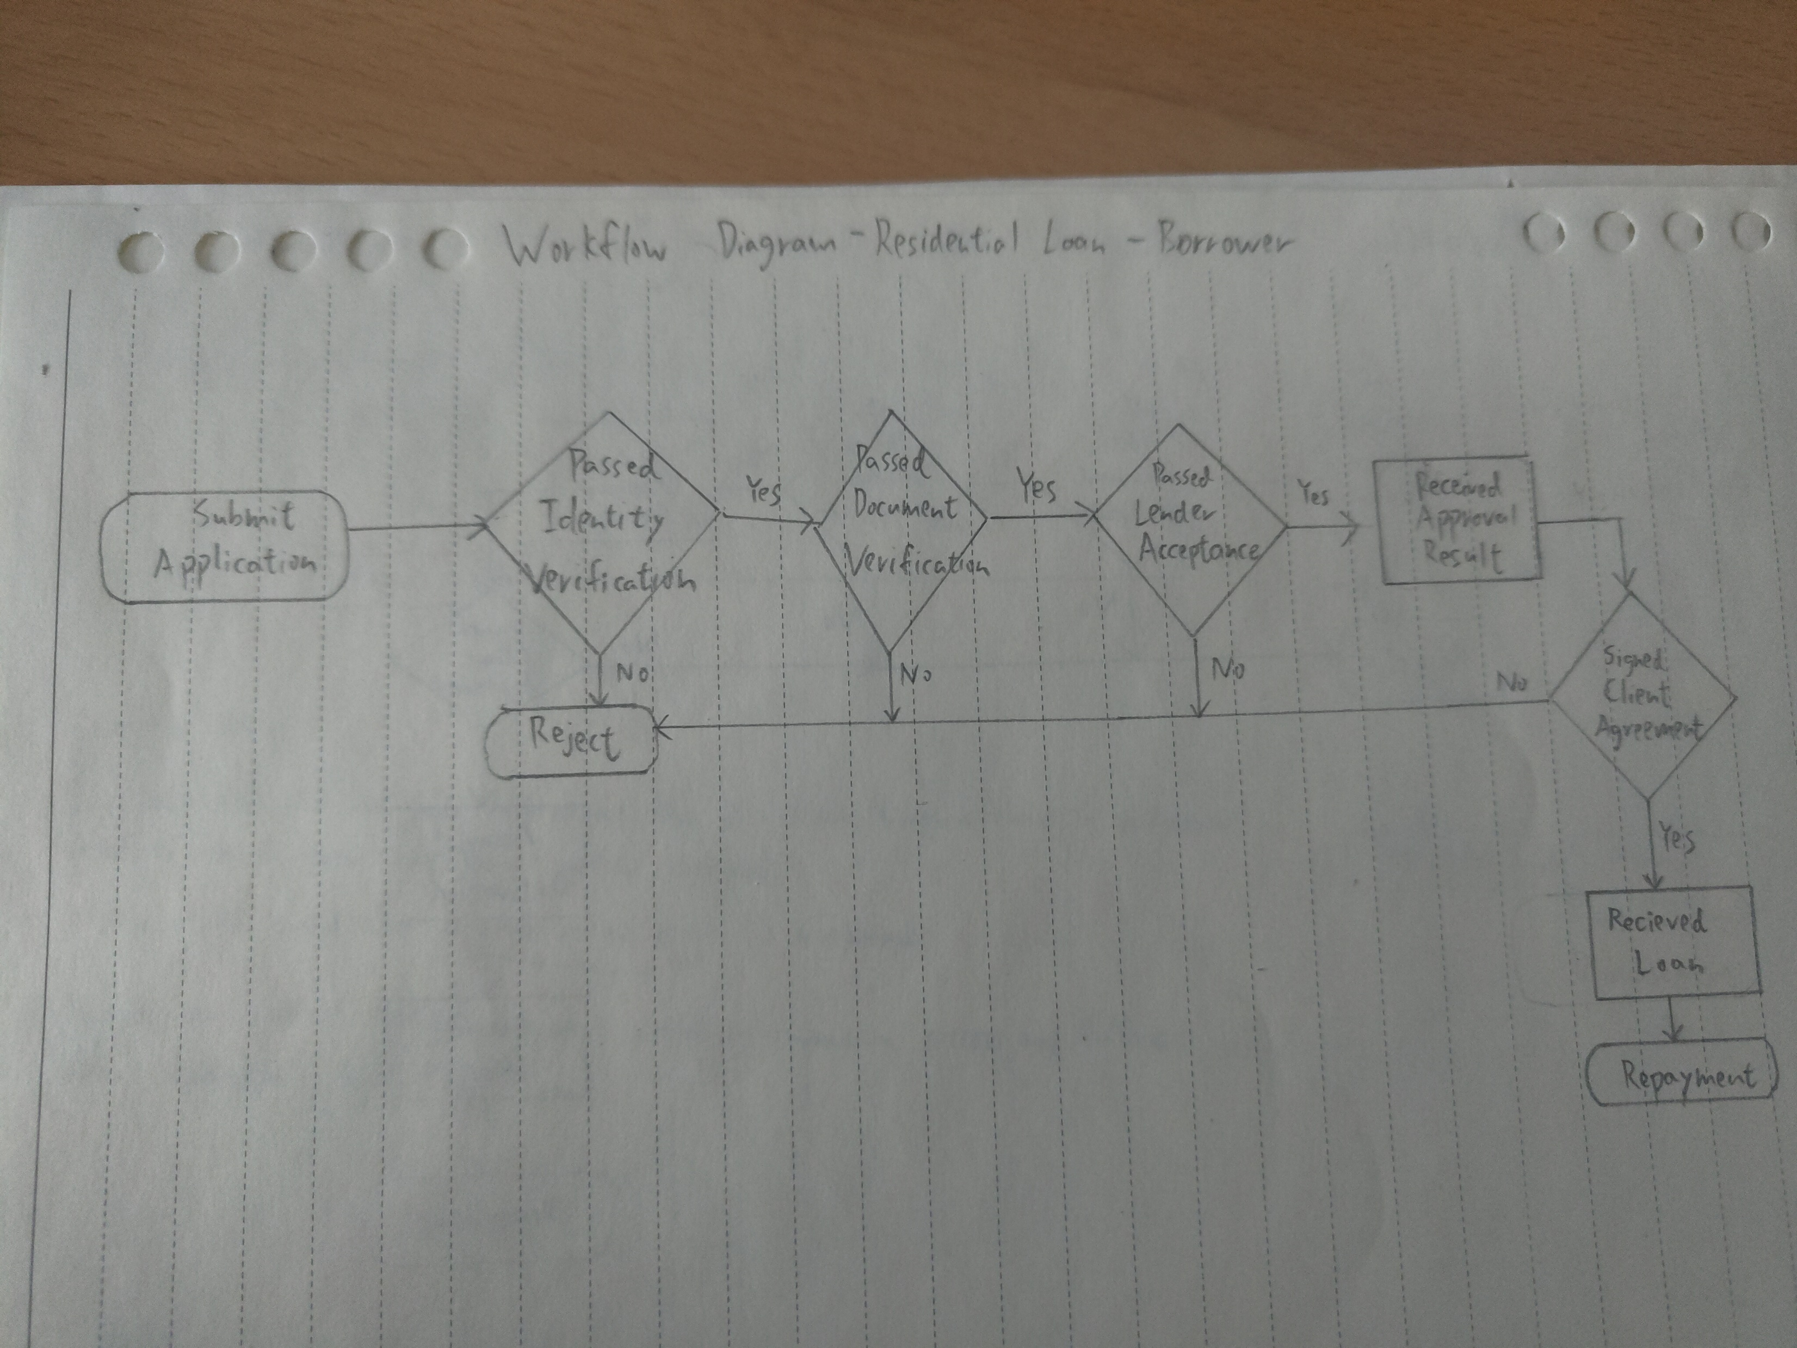
Borrower journey – Residential Loan
Assumption:
Diagram for Happy Flow for borrower only
Loan agreement is attached when borrower receiving approval result
Identity verification is a one-step simply process for borrower, and they gets the result instantly
In happy flow, document verification and lender acceptance were completed by system in real-time. Borrower gets the results of each process in a very short period. Waiting period ignorable.
Client agreement is digitally signed through portal in real-time.
Portal had automated loan disbursement process for happy flow borrower.

Slide 8
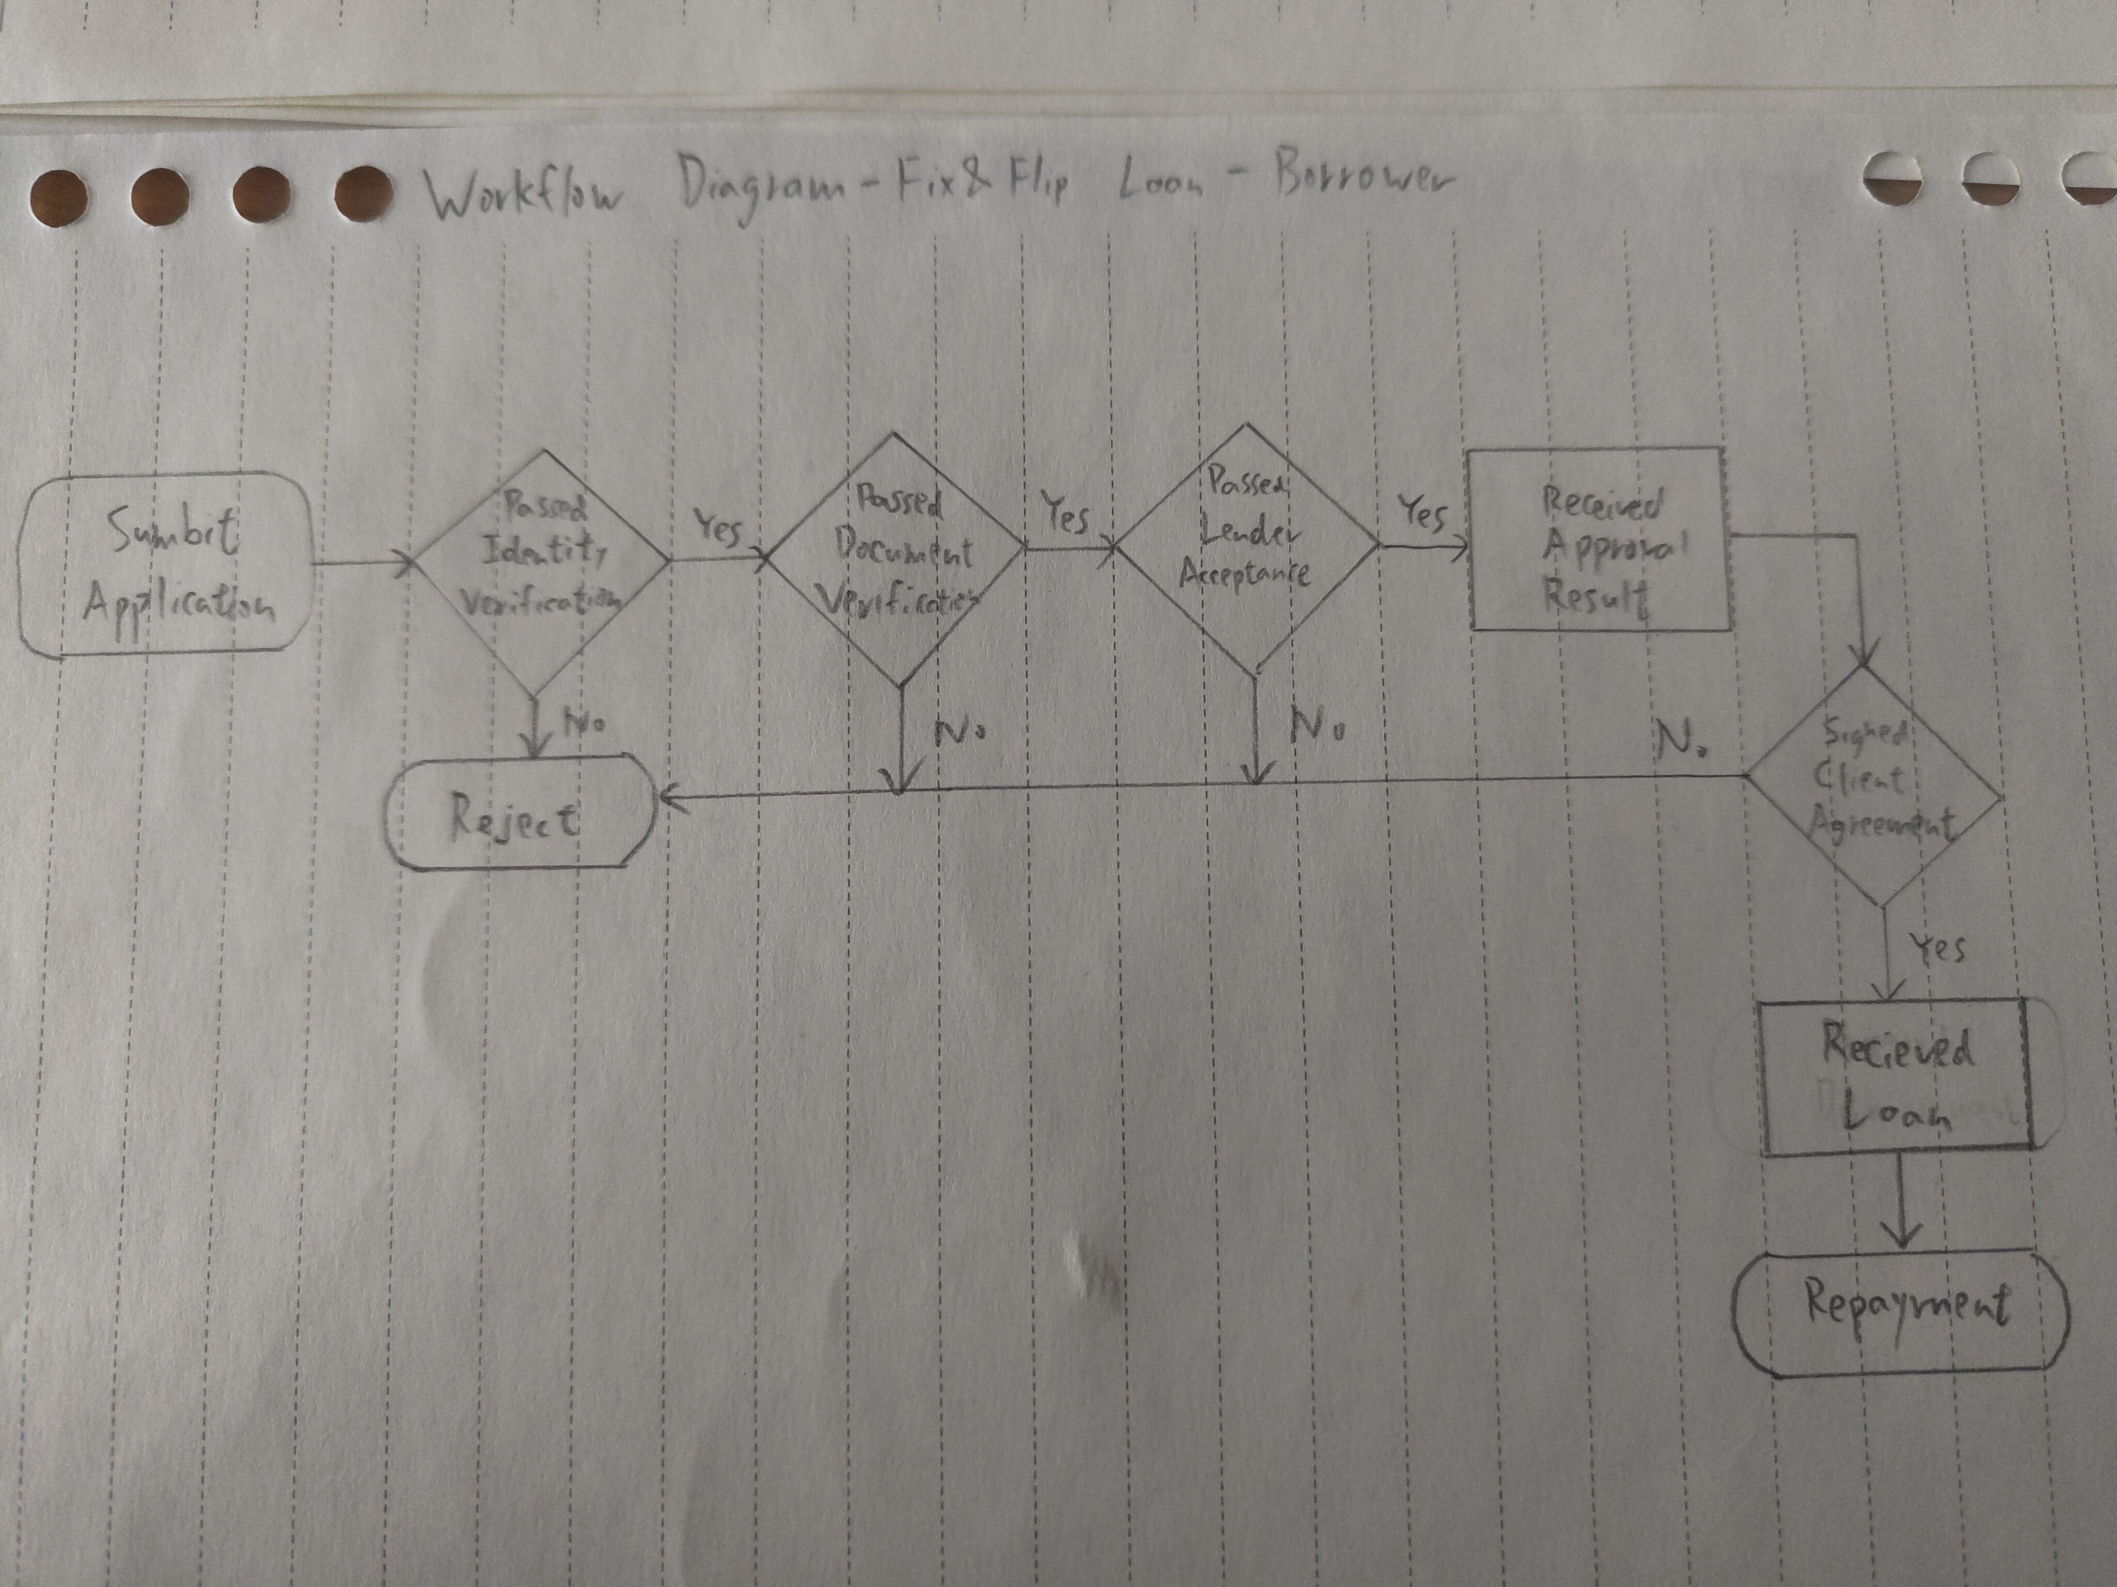
Borrower journey – Fix & Flip Loan
Assumption:
Same approval process with Residential Loan in happy flow (Fix & Flip Loans) for borrower
Loan agreement is attached when borrower receiving approval result
Identity verification is a one-step simply process for borrower, and they gets the result instantly
In happy flow, document verification and lender acceptance were completed by system in real-time. Borrower gets the results of each process in a very short period. Waiting period ignorable.
Client agreement is digitally signed through portal in real-time.
Portal had automated loan disbursement process for happy flow borrower.
Remarks:
Main differences in Fix & Flip loans when compared to residential loans:
Document submission requirement is different: renovation quotation and schedule plan are needed
Disbursement process might split into stages instead of one-time
Higher interest rate
Shorter tenor

Slide 9
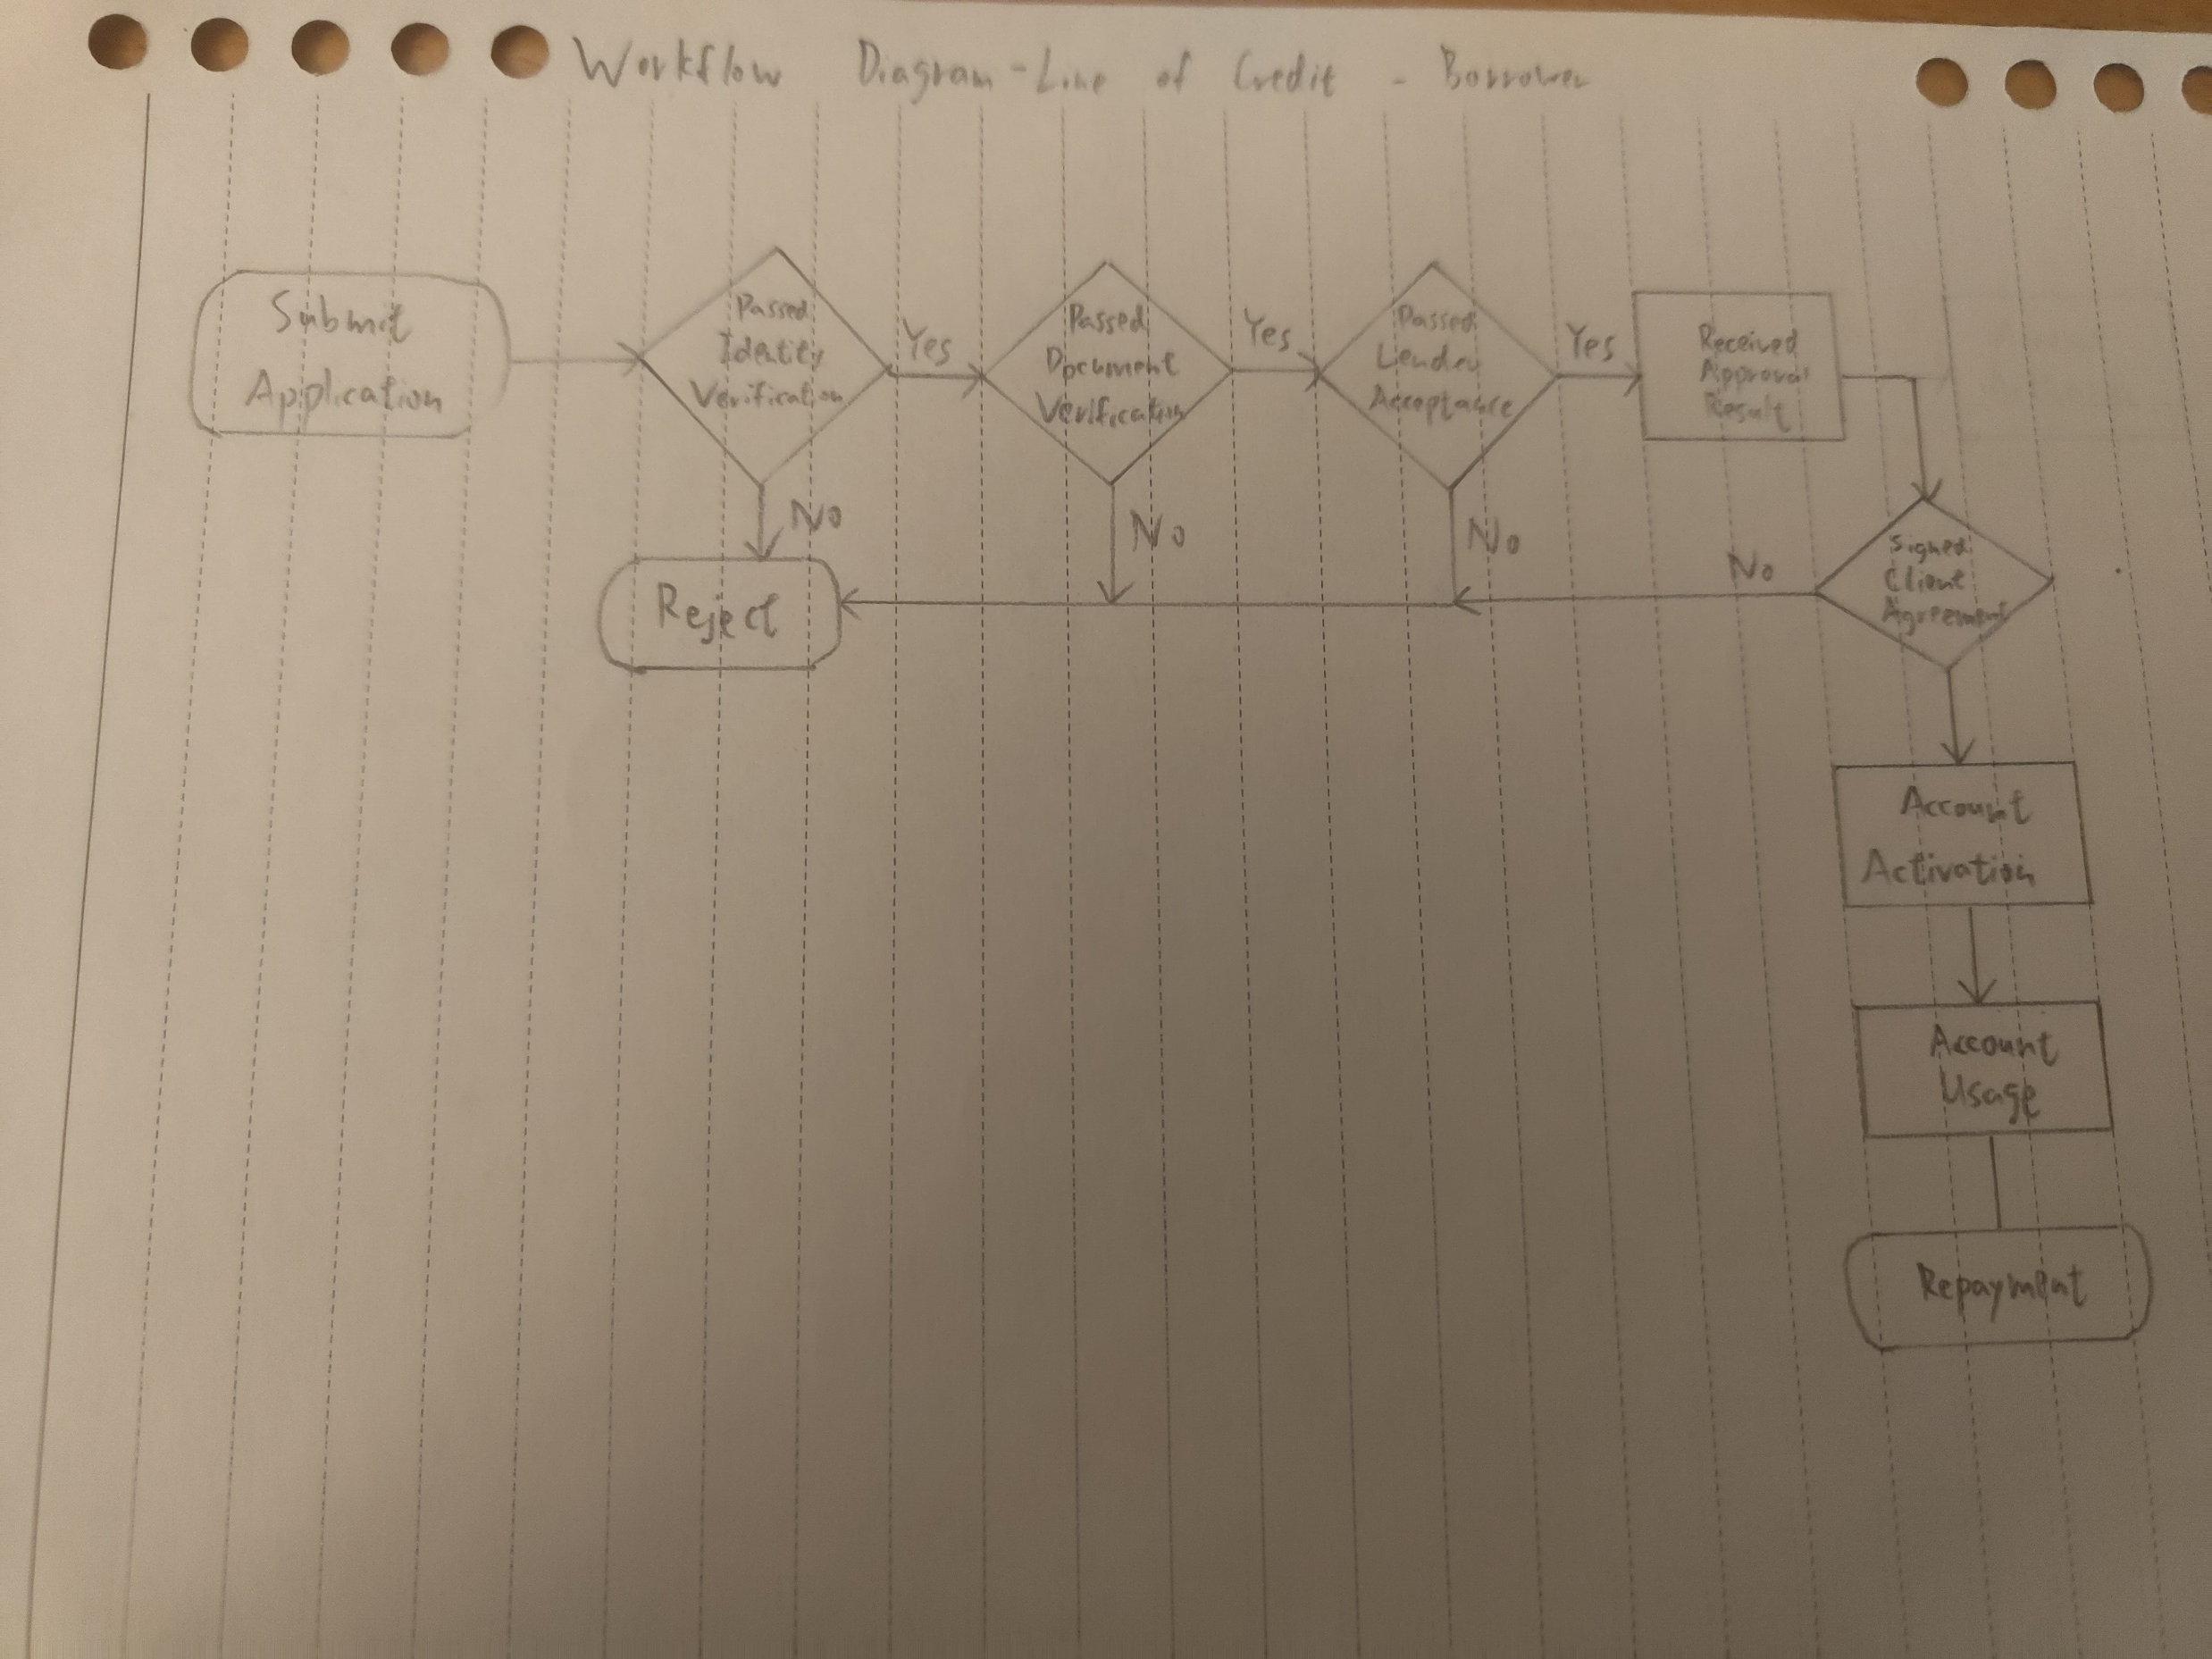
Borrower journey – Line of Credit
Assumption:
Same approval process with Residential, Fix & Flip Loans in happy flow (Line of Credit) for borrower
Loan agreement is attached when borrower receiving approval result
Identity verification is a one-step simply process for borrower, and they gets the result instantly
In happy flow, document verification and lender acceptance were completed by system in real-time. Borrower gets the results of each process in a very short period. Waiting period ignorable.
Client agreement is digitally signed through portal in real-time.
Portal had automated loan disbursement process for happy flow borrower.
Lender have full decision in reviewing client account status and renewal for client agreement
Client won’t actively asking for account renewal/ closure
Remarks:
Main differences between Line of Credit and the other two types of loans:
No disbursement process. If no account usage, no repayment process.
Line of credit products can have short or long duration with client, depending on the specific product features.
Detailed workflows for different line of credit products may be different

Slide 10
Minimal Viable Product
Mock-up screens for borrower workflow:
Design by using Canva resources:
https://www.canva.com/design/DAF6Yt1VP_o/hqxiDU9a1EXXIXzPJiczuQ/edit?utm_content=DAF6Yt1VP_o&utm_campaign=designshare&utm_medium=link2&utm_source=sharebutton
Assumption:
System requirements on 3 types of product are universal, minimal adjustment needed for facilitating all use cases.
Details in application form, declaration, consent, agreement, product information, dashboards are to-be-confirm.
Mock-up screen is the happy flow of borrower journey in residential loan application only.
Imaginary company name ‘Easylend’ and logo were used

Slide 11
Q2 Task 1 & 2
I would be starting by gathering comprehensive information about the platform and business workflows. I would look for any existing reports / documentations in performance metrics and business workflows. Approaching product managers, project managers, business stakeholders to get more information in user expectations, roles of stakeholders in workflows. Arranging interviews with end-users, technical team leaders to get the actual figures in system performance issues, getting answers for following questions:
Which system / manual process is causing the delays on platform? Any UI issues?
How the actual ‘normal’ and ‘delayed’ processing times are? How do we define them?
Are there any obstacles from lender side? How can we resolve them?
Are those performance data accessible from database/ analytic tools? If not, can we add them back?
Which part of the process (break down whole process into minimal unit) might be the root case in causing delays?
Any technology tools we can leverage to address the problem/enhancing the system performance?
Do we have the capability to fix the identified issues?
How our system performance is different from market competitors?
If it is manual process causing the delays, propose possible solutions, for example providing platform training to end-users, simplifying manual process. If it is caused by system process, work with technical leaders in identifying technology tools for enhancement possibilities to reduce process duration. Starts evaluating resources, options and its pros and cons. Gets mutual consent from stakeholders in enhancement details, project timeline, budget. Collaborated in cross-functional team to work on software development lifecycle, ensure deliverables are meeting quality standards and deadlines, prioritize tasks and support enhancement implementation, maintain transparent communication within project team. At the mean time, build a comprehensive project knowledge database to ensure documentations are well-organized (avoid knowledge loss and facilitate knowledge transfer), set up regular meetings with developers to track development progress, set up feedback mechanism to collect user opinions, leverage system data analytics for on-going enhancement project reference.

Slide 12
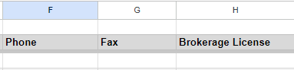
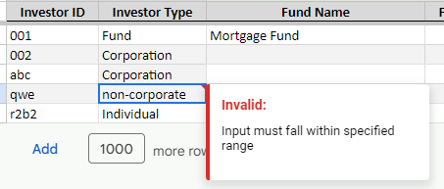
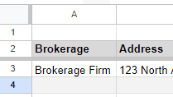
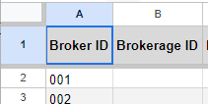
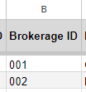
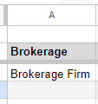
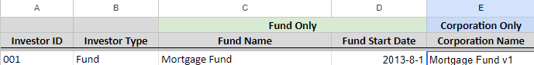
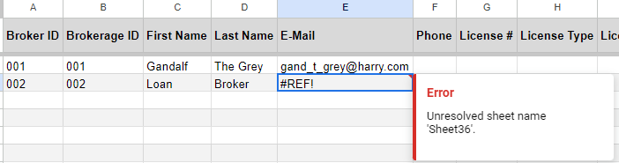
Q3 Data Analysis
In summary, the types of error can be categorized into 6:
‘Missing Value’, example: Refers to picture A
Worksheet “Brokerage” > Row 3 > Columns (F, G, H) title ”phone”, ”fax”, “brokerage license”
‘Data Format Issue’, example: Refers to picture B
Worksheet “Investor Profiles” > Row 6 > Column ( B) title “Investor Type”
‘Worksheet Structural Problem’, example: Refers to picture C
Worksheet “Brokerage” > Column ( A) title “ID” is missing (Please refers to Import Template)
‘Data Not Align Between Worksheets’, example: Refers to picture D
Worksheet “Broker” > Row 2, 3 > Column ( A) title “Broker ID” with input “001” and “002”,
corresponding Broker ID with details not found in worksheet “Brokerage”
‘Redundant Data’, example: Refers to picture E
Worksheet “Investor Profiles” > Row 3 > Column E title “Corporation Name”
‘Incorrect Input’, example: Refers to picture F
Worksheet “Broker” > Row 3 > Column E title “E-Mail”
Input is not in expected structure
P.S.: List of found errors for first 20 rows were recorded in excel file “Data analysis-screening result record”
Picture A
Picture B
Picture C
Import Template
Picture D
Picture E
Picture F

Slide 13
Q3 Data Analysis - Assumptions:
Questionable data such as abnormal loan amount, broker fees etc are not causing issues in data migration process, therefore excluding from error type
The given import template (viewable rows of data) represents most of the error cases in the whole datasets
Dataset are balanced, errors are normally distributed
Excel formula, source reference are not allowed in import template
Different error types are equally important from perspective in causing failure in data migration, no prioritization on critical levels is needed (except a cross-worksheets error is highlighted)
Client is experienced in data error handling, and is capable to investigate and fix their data issues independently given error log is provided
Imaginary client name ‘Mr. Anderson’ was used

Slide 14
Q3 Data Analysis
Task 2 - Help structure an email back to the client, asking them to please correct their mistakes, so we don’t have to take on the workload of cleaning up their data.
Email Title: Welcome Aboard! Important Data Migration Details
Dear Mr. Anderson,
Hope you're doing well! We're excited to have you on board and start working together in this new year.
Thank you for promptly submitting the import template. We're eager to help you in getting familiar with the data import process.
Our team checked the template you sent, and we noticed a few things that may need attention to ensure a smooth process. Here are a couple of examples:
Missing Value:
In the "Brokerage" sheet, the cells in row 3, columns (F, G, H) with the titles "phone," "fax," and "brokerage license" are missing value.
Data Format Issue:
In the "Investor Profiles" sheet, the cell in row 6, column (B) with the title "Investor Type" is not a valid format input.
Worksheet Structural Problem:
In the "Brokerage" sheet, the mandatory column starting from column A with the title "ID" may have been accidentally deleted by your team.
Data Not Align Between Worksheets
In the “Broker” sheet, the cells in rows 2&3, column A with the title “Broker ID” are not align with the cells in “Brokerage” sheet, row 3&4, column A with the title “ID”
Redundant Data:
In the "Investor Profiles" sheet, the cell in row 3, column (E) with the title "Corporation Name" should be empty as this column is for corporations only.
Incorrect Input:
In the "Broker" sheet, the cell in row 3, column (E) with the title "E-Mail" is not an expected structure input.
Questionable Data: (recommend to have a data check to ensure data accuracy)
In the "Loan Import" sheet, the cells in rows 6 and 7, column (R) with the title "Funding Date" show input from the year 1900.
Fixing these bits will help things run even better. If you have questions or need help, check out the import instructions and the error log I’ve attached in the email.
And feel free to reach out if you're unsure about anything.
We're here to help, and your assistance in fixing these matters will make a huge difference. Thanks for choosing us! We’re excited about working with you.
Warmest regards,
Franco Fan
Business Analyst
(433) 644-9367
Mortgage Automator
Attachments: 1) Import instructions video, 2) Data analysis-error log

Slide 15
Behavioural Questions
Q1 https://youtu.be/LAIgBfzyVIA
A few years ago, I held a senior position in the busiest bank in the city, armed with experience and client resources that laid the foundation for a successful career. I was always driven to do more, pushing myself to ascend the career ladder swiftly. Then, Covid-19 arrived, reshaping the dynamics of how banks operated, including my role. My performance suffered, mirroring the challenges faced by the entire industry.
Faced with this challenge, I had two options. Colleagues advised patience, urging me to wait for industry changes: 'The situation will improve; you just need to be patient – that's how it works.' Alternatively, I could seize the opportunity to embrace technology, restarting my career from the beginning. I chose the challenging path, prioritizing skill development to ensure adaptability in our ever-changing world.
Returning to school, I immersed myself in learning, acquiring skills essential for future career challenges. A few years later, I re-entered the industry, working on projects I loved, and my career path became even better than before. Often, we overthink, held back by our comfort zones, losing the passion to challenge ourselves in learning and long-term development. Having the courage to act and take risks is essential for growth.
In challenging situations, focusing on a singular target, maintaining faith, and having the will to overcome obstacles lead to success. It's just a matter of time until we achieve our goal. Consistency will help us in achieving our goal.

Slide 16
Behavioural Questions
Q2 https://youtu.be/VkALwrj2gW
I still remember the time when I first started working as a business analyst in the tech industry. During that period, my team was focused on developing digital solutions to facilitate our company's transformation from traditional lending business. Our objective was to launch our digital products within a specified timeline. Initially, everything went smoothly, and we were hitting every milestone. Suddenly, several colleagues decided to leave the company, creating a shortage of developers, project managers, and quality assurance personnel.
Despite our efforts to revise the project plan and reduce the project scope to meet tight deadlines, challenges persisted. I took on additional tasks in quality assurance, and our project team effectively divided the project manager's responsibilities, sharing the workload. However, a few more developers left the company without notice, resulting in a one-week delay in project deliverables. While it was undoubtedly a setback, I gained valuable insights and am confident that I could handle a similar situation better in the future.
This experience prompted me to reconsider our approach when we first learned that someone was planning to leave. Building a more connected team relationship could enhance our stability and enable us to manage risks more effectively. If given the opportunity again, I would discuss with the team to plan for a further breakdown of deliverables and seek human resources support.
This incident made me realize the paramount importance of collaboration within a team in the industry to deliver quality output. It's always a team effort rather than an individual battle. Consequently, I shifted my focus towards building relationships with my coworkers rather than solely strengthening my personal skills. This shift has rewarded me with friendships and a harmonious working environment. Collaboration plays a crucial role in personal growth as we learn from each other and generate greater output.

Slide 17
Behavioural Questions
Q3 https://youtu.be/pSDrNxTWu1c
As a practitioner in the technology industry, meeting deadlines is always the top priority in my work. Based on my experience, business opportunities are time-sensitive. The first product usually has a significant advantage in market competition, even when a better product is launched right after it. For example, ChatGPT rapidly took over the market when it was first launched. People became obsessed with it, consumer behavior stuck with it, and it easily became an iconic product. After that, subsequent products had a hard time competing with ChatGPT as consumer habits had already been established.
The same principle applies to software development. Project and delivery schedules are critical for a product in the ever-changing market. Deadlines are solid and objective, meaning the same thing for everybody. On the other hand, quality is more subjective. People could have different opinions on the quality of the same product, depending on their perspective and expectations. In project consideration, it is preferable to build a product with the consensus of most stakeholders. Focusing on meeting deadlines is thus more reasonable to fulfill expectations when compared to prioritizing quality.
To be more specific, let’s consider an example of how a project is executed: project managers set up project scope with prioritization, tasks are broken down into hourly efforts, features with lower priority are moved to later phases of deliverables, and a launch plan is constructed based on stakeholder agreement. This process is effective in ensuring that the product output follows a planned timeline, and quality control is taken care of by software testing.
What if the project team chooses quality over schedule? Let’s say the project team decided to launch the product only when the quality standard gets perfect. The project team invested most of their effort in quality testing and implemented a comprehensive testing plan with enhanced standards for launchable products. This could result in either a human resources gap or a timeline extension. Both scenarios increase the budget, negatively affecting the overall project value.
In conclusion, meeting deadlines is more important to me as the overall project value is counting on it. Timing is critical for business and will always be my priority in project tasks handling.

